Slide 1


Kano State Government, Ministry of Planning and Budget
Y2018
DRAFT FULL YEAR BUDGET PERFORMANCE REVIEW ANALYSIS

Slide 2


Outline
Revenue Appraisal
Expenditure Appraisal
Comparative Analysis

Slide 3
Y2018 Approved Budget Overview
STATUTORY ALLOCATION | 54,279,173,475
VALUE ADDED TAX | 19,189,991,330
OTHER RECIEPTS | 26,410,532,069
I G R | 53,977,623,108
CAPITAL RECIEPTS | 92,751,530,616
Total Budget Size | 246,608,850,598

Slide 4
Y2018 Approved Revenue Vs Actual Collection
 | 2018 APPROVED REVENUE | ACTUAL COLLECTION
STATUTORY ALLOCATION | 54,279,173,475 | 61,364,902,787.76
VALUE ADDED TAX | 19,189,991,330 | 19,702,931,397.47
OTHER RECIEPTS | 26,410,532,069 | 128,797,655.17
I G R | 53,977,623,108 | 44,107,375,284.25
CAPITAL RECIEPTS | 92,751,530,616 | 7,803,213,219.94

Slide 5
Y2018 Approved Expenditure
Vs
Actual Expenditure
 | 2018 APPROVED BUDGET | ACTUAL EXPENDITURE
RECURRENT | 83,426,412,502 | 80,947,644,111.1
CAPITAL DEVELOPMENT | 163,182,438,095 | 43,864,184,223
Grand Total | 246,608,850,598 | 124,811,828,334

Slide 6
Y2018 Revenue Appraisal in Percentage
 | 2018 APPROVED REVENUE | ACTUAL COLLECTION | %
STATUTORY ALLOCATION | 54,279,173,475 | 61,364,902,787.76 | 113
VALUE ADDED TAX | 19,189,991,330 | 19,702,931,397.47 | 102.67
OTHER RECIEPTS | 26,410,532,069 | 128,797,655.17 | 0.48
I G R | 53,977,623,108 | 44,107,375,284.25 | 81.7
CAPITAL RECIEPTS | 92,751,530,616 | 7,803,213,219.94 | 8.4

Slide 7
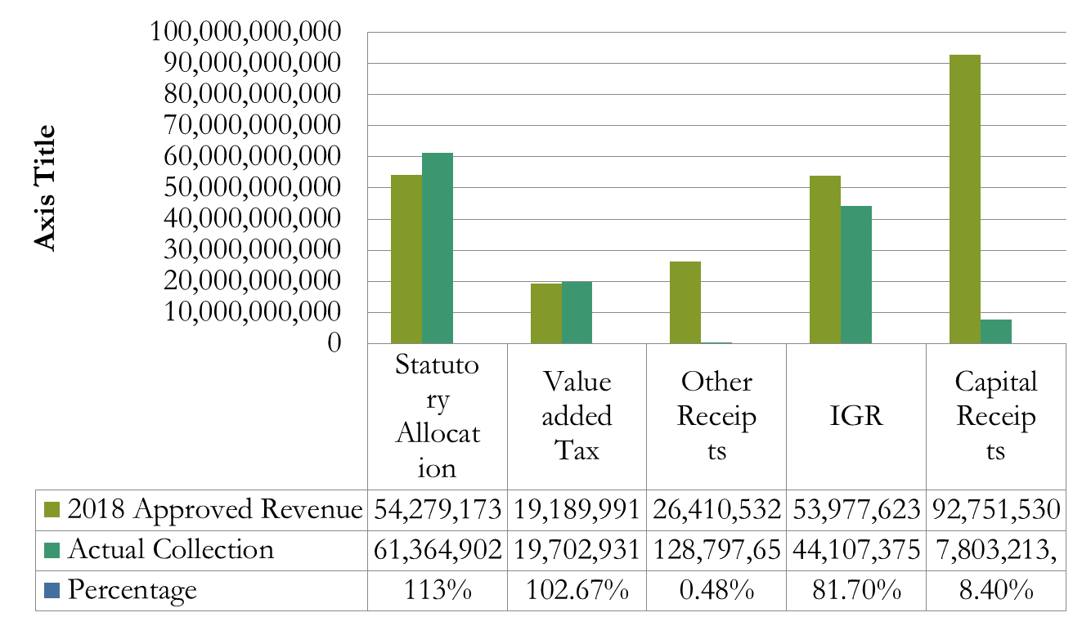
Y2018 Revenue Appraisal in Percentage

Slide 8
Annexes
Data for the draft performance appraisal / analysis were from the following:
Ministry of Finance
Kano State Internal Revenues Services
Due Process Bureau

